Slide 1
Scaling Data
Section 3
Notes:
Welcome to the third section, Scaling Data
In the previous section we created visuals from data
During that process, we manually calculated scales for various dimensions of our data, which we used to determine x and y locations, size of the bubbles, and color

Slide 2
What We’ll Learn
An overview of scales
Using scales for color
An introduction to then purpose and types of scales in D3.js
Using built-in categorical scales to map values to colors
Using linear scales
Using a linear scales to map values into horizontal and vertical axes
Notes:
In this section, we learn how to use several of the built in scaling and mapping techniques in D3.js
And how those simplify our code
In this section we will look at three topics

Slide 3
What We’ll Learn
An overview of scales
Using scales for color
`
An introduction to then purpose and types of scales in D3.js
Using built-in categorical scales to map values to colors
Using linear scales
Using a linear scales to map values into horizontal and vertical axes
Notes:
In the first video we will take a look at how scales help us map data to the display, and we will examine several of the different types of scales available in D3.js

Slide 4
What We’ll Learn
An overview of scales
Using scales for color
An introduction to then purpose and types of scales in D3.js
Using built-in categorical scales to map values to colors
Using linear scales
`
Using a linear scales to map values into horizontal and vertical axes
Notes:
With that overview of scales, we will move on to directly using linear scales to create our visuals. We’ll use these to calculate the x and y positions, and also the radius. We will also see how to simplifies our code as compared to performing manual calculations.

Slide 5
What We’ll Learn
An overview of scales
Using scales for color
`
An introduction to then purpose and types of scales in D3.js
Using built-in categorical scales to map values to colors
Using linear scales
Using a linear scales to map values into horizontal and vertical axes
Notes:
In the final video of this section, we will add to our code a color scale that selects color for our visuals based upon the regions within the data.

Slide 6
An overview of scales
Video 3.1
Notes:
Welcome to the first video of this section, An overview of scales

Slide 7
In this video, we are going to take a look at…
What is a scale and why should we use them
Understanding the concepts of domain and range
Code to demonstrate various linear and ordinal scales
Notes:
In this video, we are going to learn how to use linear scales to map our data to the visual area of our presentation

Slide 8
What is a scale?
A scale is a JavaScript function used to transform data
When creating data visualizations, we often need various types of data transformations, and scales perform this for us
D3.js provides generators to create many useful types of scales
Notes:
Continuous: map a continuous, quantitative domain to a contiguous range
Similar to a mathematical function: any number in, get a transformed number out
linear, power, square roots, log, and also time
Sequential: map a continuous, quantitative domain to a continuous, fixed interpreter
Sequential scales are similar to continuous scales in that they map a continuous, numeric input domain to a continuous output range. However, unlike continuous scales, the output range of a sequential scale is fixed by its interpolator and not configurable.
Quantize: map a continuous, quantitative domain to a discrete range:
Binning, creating bars
Ordinal: discrete codomain to a discrete range:
Good example are color maps

Slide 9
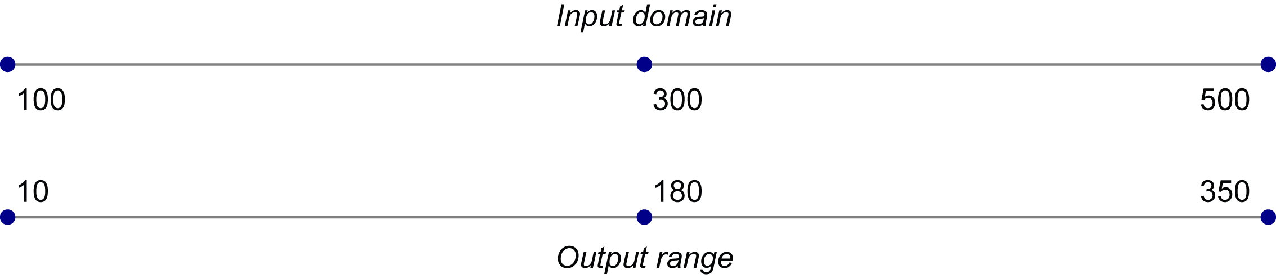
Scales map domain values into range values
Your data and its values are the domain
Domain values are normally not representative in terms of visuals
Scales create a function that converts domain values to range values

Slide 10
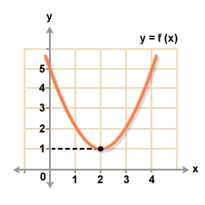
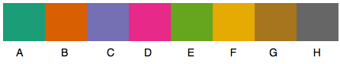
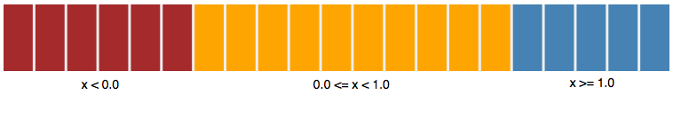
Categories of D3.js scales
Continuous
Ordinal
Sequential
Quantize
Notes:
Continuous: map a continuous, quantitative domain to a contiguous range
Similar to a mathematical function: any number in, get a transformed number out
linear, power, square roots, log, and also time
Sequential: map a continuous, quantitative domain to a continuous, fixed interpreter
Sequential scales are similar to continuous scales in that they map a continuous, numeric input domain to a continuous output range. However, unlike continuous scales, the output range of a sequential scale is fixed by its interpolator and not configurable.
Quantize: map a continuous, quantitative domain to a discrete range:
Binning, creating bars
Ordinal: discrete codomain to a discrete range:
Good example are color maps

Slide 11
Why use scales?
They simplify calculation of:
Position
Size
Color
Velocity

Slide 12
Next Video
Using linear scales
Notes:
[Mandatory Slide]
Here the name of the next video needs to be mentioned. The narration as you guessed it would be just letting the viewer know exactly where we are at and what we’d be taking over next! ☺

Slide 13
Using linear scales
Video 3.2
Notes:
In the previous video we learned about SVG elements and created lines, rectangles, circles and ellipses
This is the second video of this section, Creating visuals with data

Slide 14
In this video, we are going to take a look at…
Simplifying our code with a linear scale
Calculating both horizontal and vertical position
Calculating size of the bubbles using a scale
Notes:
In this video, we will

Slide 15
Next Video
Using scales for color
Notes:
[Mandatory Slide]
Here the name of the next video needs to be mentioned. The narration as you guessed it would be just letting the viewer know exactly where we are at and what we’d be taking over next! ☺

Slide 16
Using scales for color
Video 3.3
Notes:
In the previous video saw how to use data binding to create new visuals
This is the third video of this section, Visual styling with data

Slide 17
In this video, we are going to take a look at…
Using an ordinal scale and a categorical color scheme for our bubble colors
Notes:
This slide, like mentioned above is for multiple pointers. The information above covers the types of information that can be used in this slide

Slide 18
Summary
Learned about scales and the concepts of domain and range
Modified our code to use a linear scale for position on the horizontal and vertical axes
Used a linear scale to calculate the size of our bubbles
Used categorical scales to select colors
Examined many of the different types of color scales
Notes:
This slide, like mentioned above is for multiple pointers. The information above covers the types of information that can be used in this slide

Slide 19
Next Section
Chart Annotation
Notes:
[Mandatory Slide] This would be the introduction slide of the topic that you are covering in this subsection.
When this slide plays, you could talk about the main aim that we’d be covering in this video.

